Slide 1

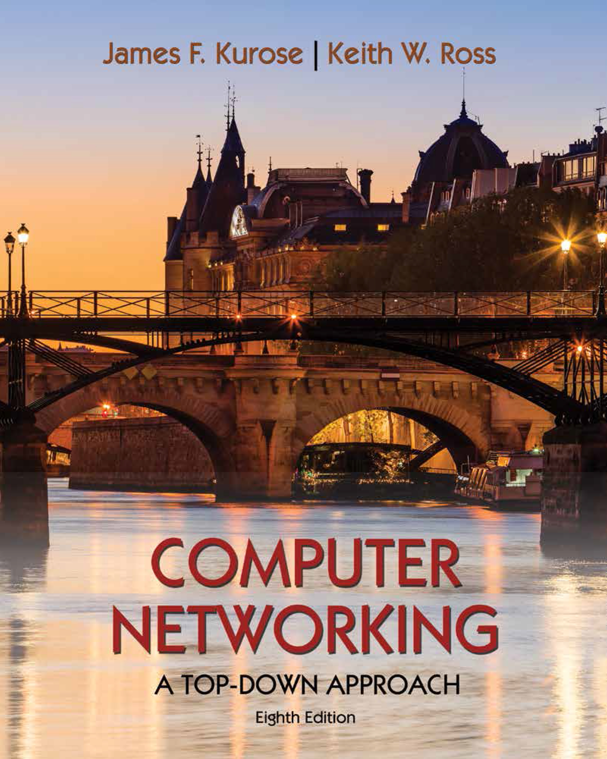
Transport Layer
COMPSCI 453 Computer Networks
Professor Jim Kurose
College of Information and Computer Sciences
University of Massachusetts
Introduction: transport-layer services
Multiplexing and demultiplexing
Connectionless transport: UDP
Principles of reliable data transfer
Connection-oriented transport: TCP
Principles of congestion control
TCP congestion control
Evolution of transport-layer functionality
Class textbook:
Computer Networking: A Top-Down Approach (8th ed.)
J.F. Kurose, K.W. Ross
Pearson, 2020
http://gaia.cs.umass.edu/kurose_ross

Slide 2
Transport layer: overview
Our goal:
understand principles behind transport layer services:
multiplexing, demultiplexing
reliable data transfer
flow control
congestion control
learn about Internet transport layer protocols:
UDP: connectionless transport
TCP: connection-oriented reliable transport
TCP congestion control

Slide 3

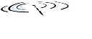




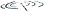






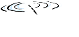


Transport services and protocols
application
transport
network
data link
physical
provide logical communication between application processes running on different hosts
mobile network
national or global ISP
transport protocols actions in end systems:
sender: breaks application messages into segments, passes to network layer
receiver: reassembles segments into messages, passes to application layer
logical end-end transport
local or regional ISP
home network
content
provider
network
application
transport
network
data link
physical
datacenter
network
two transport protocols available to Internet applications
TCP, UDP
enterprise
network
Notes:
By logical communication , we
mean that from an application’s perspective, it is as if the hosts running the processes
were directly connected; in reality, the hosts may be on opposite sides of the
planet, connected via numerous routers and a wide range of link types. Application
processes use the logical communication provided by the transport layer to send
messages to each other, free from the worry of the details of the physical infrastructure
used to carry these messages.
Let’s look at each of these three (logical communications, actions,

Slide 4
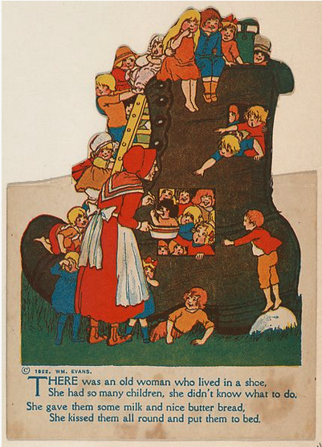
Transport vs. network layer services and protocols
household analogy:
12 kids in Ann’s house sending letters to 12 kids in Bill’s house:
hosts = houses
processes = kids
app messages = letters in envelopes
transport protocol = Ann and Bill who demux to in-house siblings
network-layer protocol = postal service

Slide 5
Transport vs. network layer services and protocols
network layer: logical communication between hosts
transport layer: logical communication between processes
relies on, enhances, network layer services
household analogy:
12 kids in Ann’s house sending letters to 12 kids in Bill’s house:
hosts = houses
processes = kids
app messages = letters in envelopes
transport protocol = Ann and Bill who demux to in-house siblings
network-layer protocol = postal service

Slide 6
Transport Layer Actions
Sender:
application
application
is passed an application-layer message
app. msg
determines segment header fields values
T_{h}
transport
app. msg
transport
T_{h}
creates segment
network (IP)
network (IP)
passes segment to IP
link
link
physical
physical

Slide 7
Transport Layer Actions
Receiver:
application
receives segment from IP
application
checks header values
transport
transport
app. msg
extracts application-layer message
network (IP)
network (IP)
demultiplexes message up to application via socket
link
link
physical
physical
app. msg
T_{h}

Slide 8
Two principal Internet transport protocols
application
transport
network
data link
physical
TCP: Transmission Control Protocol
reliable, in-order delivery
congestion control
flow control
connection setup
UDP: User Datagram Protocol
unreliable, unordered delivery
no-frills extension of “best-effort” IP
services not available:
delay guarantees
bandwidth guarantees
mobile network
national or global ISP
logical end-end transport
local or regional ISP
home network
content
provider
network
application
transport
network
data link
physical
datacenter
network
enterprise
network

Slide 9

Transport Layer
COMPSCI 453 Computer Networks
Professor Jim Kurose
College of Information and Computer Sciences
University of Massachusetts
Introduction: transport-layer services
Multiplexing and demultiplexing
Connectionless transport: UDP
Principles of reliable data transfer
Connection-oriented transport: TCP
Principles of congestion control
TCP congestion control
Evolution of transport-layer functionality
Class textbook:
Computer Networking: A Top-Down Approach (8th ed.)
J.F. Kurose, K.W. Ross
Pearson, 2020
http://gaia.cs.umass.edu/kurose_ross
Video: 2020, J.F. Kurose, All Rights Reserved
Powerpoint: 1996-2020, J.F. Kurose, K.W. Ross, All Rights Reserved

